Slide 1

Synthetic data
Andrew Wang, Jaime Wu
Notes:
Introduce ourselves
Our project is focused synthetic data

Slide 2
Contents
Project Introduction
Literature Review & Related Works
Project Scope
Unambiguous Synthetic QA Generation
Question Enhancement
Results & Discussions
Conclusions & Next Steps
RAG Pipeline
Dense Vector Round Trip Consistency Method
Notes:
Today we will go over these topics
We will start with introducing our project, the literature and current issues that form our project scope
From there, we will go through our methodology and the data-centric approaches we took
Finally, we will discuss our results, limitations, and next steps

Slide 3

Project introduction
What are the current systems for question-answering?
Factoid open-domain question-answering (ODQA)
Information retrieval (IR) and machine reading comprehension (MRC)
Our research mainly focus on Retrieval Augmented Generation (RAG) for question-answering
Notes:
There is currently no simple mechanism for users to ask a question and have a system or model to search through a knowledge base and respond with an answer.
Such a system would be useful for researchers to …. For example …
In the literature, ODQA is a fundamental NLP challenge trying to solve this problem; whereby systems consists of an IR component and MRC component to answer factoid questions
A new state of the art model called RAG follows this architecture
Our project will mainly focus on RAG and improvements to RAG.

Slide 4

Literature review

Slide 5
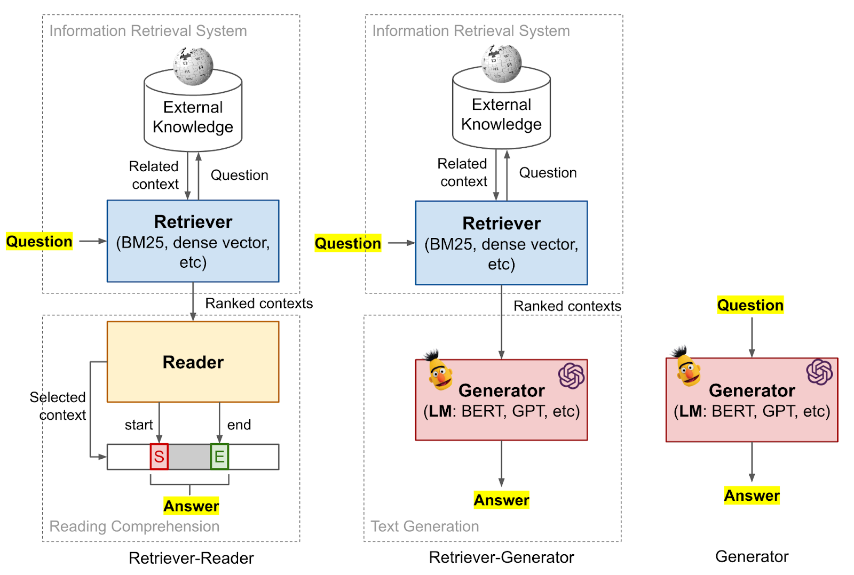
Open-Domain Question-Answering (ODQA)
Open Book
Closed Book
Notes:
ODQA is a type of system that is able to answer factoid questions from a vast knowledge base, spanning several subject areas.
There is two different forms of open-domain question-answering (1) open book (2) closed book
Open book is when questions are answered using the help of information retrieved from an external source.
Therefore, open book models usually contain:
IR component for retrieving relevant documents to answer the question
MRC component for interpreting the documents to produce an answer
Furthermore, these models can either be extractive or generative, that is, the answer is either extracted from a set of passages or generated by the model itself.
Closed book is when no information from an external source is used.
Given a question, the model will be able to generate an answer directly, using the knowledge base contained within the model.
Usually closed book models stores the training data directly within its parameters/weights
Our project mainly focused on open book QA where we would retrieve documents from an external knowledge base to answer the question
Our main focus is on the RAG model

Slide 6
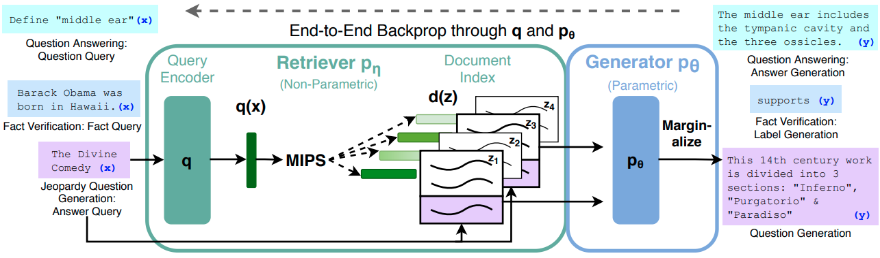
Retrieval Augmented Generation (RAG)
RAG is a novel end-2-end architecture
Dense Passage Retriever (DPR) for information retrieval (IR)
BART for machine reading comprehension (MRC)
Outperforms current models, establishing a new state-of-the-art performance for knowledge-intensive NLP tasks such as question-answering
Notes:
RAG is novel end-2-end, it differs from prior ODQA systems as both the IR and MRC components are trained jointly (end-2-end). Prior models train each component independently
RAG uses DPR as the information retrieval (IR) component
RAG uses a seq-2-seq BART generator as the machine reading comprehension (MRC) component
Outperforms current models, establishing a new state-of-the-art performance for knowledge-intensive NLP tasks such question-answering

Slide 7




How does RAG WORK?
“Mammal …”
When did the first mammal appear on Earth?
Search through knowledge base
178 million years ago …
“History of Earth …”
Produce answer
“Evolution of Mammal …”
Notes:
How does RAG work? It first takes in a question, for example, “When did the first mammal appear on Earth?”.
RAG takes this question and passes it into the DPR, which then searches through the knowledge base for documents that relate.
The documents are ranked based on a similarity score, and the top-k documents are passed to the BART generator.
The BART model then uses these documents to generate an answer.

Slide 8
WHY RAG?
Ability to utilise pre-trained knowledge which enables understanding of language
1
Can change domains and knowledge base without retraining the entire model
2
Greater interpretability and minimal hallucinations
3
Notes:
RAG’s main feature enables the ability to use
Pre-trained knowledge, present within the parameters, such an understanding of language/semantics (we call this the parametric memory)
Knowledge found in an external knowledge base, which can be readily changed on the fly allowing researchers and engineers to manage what RAG knows without spending time or computing power retraining the entire model (we call this the non-parametric memory)
RAG has desirable features such as interpretability and minimal hallucination, because the we can see the retrieved passages, and the model generates an answer from only the retrieved passages to minimize hallucination

Slide 9
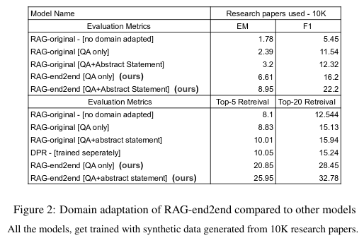
Related work rag full end-2-end
RAG was originally designed to be fine-tuned in a partial end-2-end manner
Siriwardhana et al. fine-tuned the overall RAG architecture in a complete end-2-end manner
Notes:
The authors of the original paper justified that fine-tuning the whole system end-2-end is too computationally expensive and not easily achievable (P. Lewis, Perez, et al., 2020).
RAG was originally designed to be fine-tuned in a partial end-2-end manner since only the input encoder and output generator is trained end-2-end, while the DPR’s weights are frozen and trained independently
However, a related piece of work by Siriwardhana et al. showed that fine-tuning the overall RAG architecture (all three components including the DPR) in a complete end-2-end manner, intelligently, resulted in considerable improvements (Siriwardhana et al., 2021) (Figure 3).
Based on these findings, our research aims to develop novel data-centric techniques, rather than architectural modifications (as this has already been achieved by Siriwardhana et al.).
As you can see the table shows that for top5 retrieval, RAG full increase in EM score from 10% to 25%

Slide 10

Project scope

Slide 11
issues & areas of research
Lack of annotated data available for training RAG
Ambiguous QA pairs for training RAG
Architectural modifications already explored
Our research focuses on data-centric techniques
Notes:
Lack of annotated data available for training RAG
Ambiguous QA pairs for training RAG
Give example: What is the purpose of this study? Given this question, hard to find relevant documents/passages to answer question
Architectural modifications already explored
Therefore, our research aims to develop novel data-centric techniques to improve RAG

Slide 12
Project scope
Direct Contributions
Indirect Contributions
Synthetic Data via Abstractive Summarisation
Synthetic Data via Question Enhancement
RAG Pipeline Implementation
Implement Filtration Technique
Notes:
This then leads to our project scope for improving RAG’s performance in ODQA
We identified two minor contributions for improving RAG indirectly
Implement an efficient and effective RAG pipeline to quickly train and fine-tune various models and provide a consistent method for model evaluation.
Improve round trip consistency to better filter synthetic data by using dense vector representation of the answers instead of a lexical (extractive) approach.
The last two bullet points are our two main contributions for improving RAG’s performance in ODQA
We have generated a synthetic dataset based on the idea of abstractive summarisation. We basically use the summary of a passage as an answer for the synthetic question-answer pair.
We have generated another synthetic dataset with an enhanced question input

Slide 13
Main Hypotheses
Synthetic Data via Abstractive Summarisation
We observed the current extractive approach can sometimes lead to ambiguous synthetic QA pairs.
Synthetic Data via Question Enhancement
Motivated by this, we introduce an abstractive summarisation approach.
We think that a summary for an answer will likely provide a more factual answer, from which we can generate less ambiguous questions.
We believe that less ambiguous synthetic QA pairs may improve the performance of RAG.
We observed the retriever component struggles to find relevant information.
From this, we developed an idea to concatenate additional lexical matching results to the synthetic question.
BlenderBot 2.0 significantly improved performance using an internet search prior to input.
We believe this provides the DPR additional help when retrieving documents to improve question-answering.
Notes:
We observed that in some ODQA settings, the current extractive approach can lead to ambiguous synthetic QA pairs.
In the extractive approach, the final output layer produces a log-likelihood distribution of the most likely answer locations within a passage.
We argue that this approach can lead to ambiguous question-answer pairs because some extracted answers may neglect the context and overall meaning of the passage
Therefore, the input question becomes too ambiguous, which makes it difficult for the model to retrieve documents and answer the question.
Motivated by this, our first major contribution introduces a novel synthetic question-answering (QA) mechanism using an abstractive summarization approach
We think that a summary for an answer will likely provide a more factual answer, from which we can generate less ambiguous questions.
We believe that less ambiguous synthetic QA pairs may improve the performance of RAG.
Although synthetic data alone can improve the performance of the BART model, we observed the retriever component often still struggles to find relevant information.
Furthermore, the uncertainty of the input questions motivated us to increase the amount of information supplied to the input.
For instance, BlenderBot 2.0, a novel opensource chatbot, significantly improved long term memory performance using an internet search query prior to the input.
Similarly, our second approach concatenates extra information (e.g. passages) to the input question using a lexical matching approach.
We therefore provide the retriever with an improved, information-rich, input, which aims to improve RAG’s retrieval performance for question-answering.

Slide 14

Methodology
Indirect Contributions
RAG Pipeline
Dense Vector Round Trip Consistency
Notes:
We consider these two tasks to be indirect contributions because we cannot directly quantify how much they contribute to the performance of RAG. By having an efficient RAG pipeline, we can easily swap out sets of data and components, therefore, saving time. While using a dense vector round trip consistency filtration method, gives us the ability to improve the quality of generated synthetic data. These two contributions set the foundation for our two main contributions.

Slide 15
Rag pipelines
1. Original RAG
2. RAG Full End-2-End
We implemented a pipeline for the original RAG model, consisting of:
Data preparation (Convert data into DPR training format)
Model fine-tuning/training (DPR + BART using Haystack)
Model evaluation (COVID-QA data set)
Benchmark pipeline for verification
Pipeline was implemented by Siriwardhana et al. (PhD supervisor)
Siriwardhana et al. conducted the model training and evaluation as this requires access to AHLab’s VM
This pipeline will be the final source of our research results
For consistency, results are reconciled between pipelines
Notes:
As a preliminary step, a RAG pipeline was implemented.
We need a RAG pipeline to allow us to exchange the training data easily, fine-tune RAG, and evaluate the model using a benchmark data set (COVID-QA)
We decided with two RAG pipelines, one for the original RAG which was partially end-2-end, one for RAG full end-2-end
We only implemented the pipeline for the original RAG → Read off slides
… pipeline for verifying …
The second pipeline for full RAG was implemented by our Phd supervisor as part of his PhD project. We were unable to use this pipeline as it required access to Ahlab’s VM
We used the second for our final results due to related work, and our first pipeline will be used to verify and ensure consistent results.

Slide 16
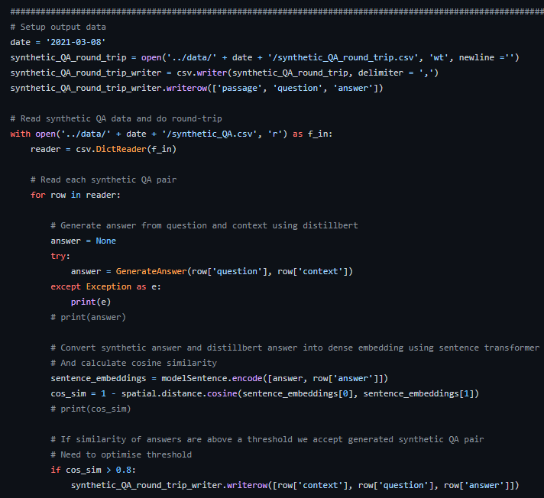
Dense Vector Round trip consistency
Round-trip consistency filters synthetic QA pairs
The method employs a fact checking approach
We used dense vector embeddings instead of exact matching
Improved quality of filtered data
Notes:
Our second indirect contribution was to improve the round trip consistency method for filtering synthetic QA data
Round trip consistency method generates an answer using the synthetic data to fact-check the synthetic answer. This method filters the data if the answers are different.
The current version of round trip uses exact matching. Our version uses dense vector embeddings to represent how closely relate the answers are.
We think that this retains better quality data, so we used our version of round trip to filter our main contributions’ synthetic data.

Slide 17
Methodology
Direct Contributions (Synthetic Data)
Abstractive summarisation
Question Enhancement

Slide 18
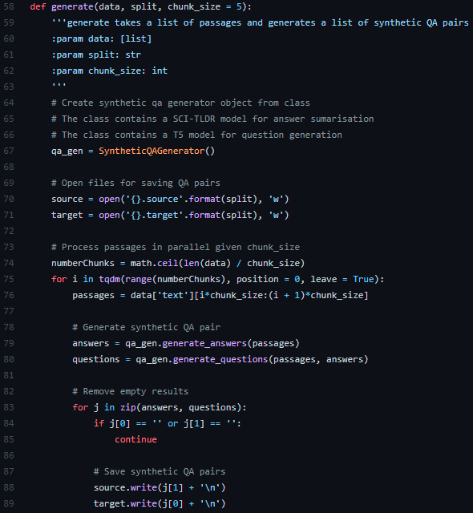
abstractive summarisation
Extractive models are currently used to generate synthetic QA pairs
We take an abstractive summarisation approach for less ambiguous QA pairs
Our algorithm can be summarised as follows:
Iterate through a list of passages
Generate answer using SCI-TLDR (summarisation instead of extraction)
Generate question using T5 model
Save synthetic QA pair
Our algorithm generate batches of QA pairs in parallel
Notes:
Our algorithm takes an abstractive summarization approach to generate synthetic QA paris verses the extractive approach in the literature.
Using a neural summarisation model such as SCI-TDLR, trained specifically for scientific papers, we summarise the 100 word passages to obtain a synthetic answer
We then use a T5-based question generator to generate a synthetic question given the summary and the 100 word passage
With the synthetic QA pair, we employ the above dense vector round-trip consistency method to filter the data.
Our algorithm generates a batch of QA pairs in parallel, and this is important because we were utilising Google colab to generate this data.

Slide 19
examples
Question | Answer | Context
What is an example of a virus that initiates sg mRNA synthesis internally? | brome mosaic virus… | Some viruses, such as brome mosaic virus, initiate sg mRNA synthesis internally on the full-length minus strand RNA template…
What is mycoplasma pneumoniae? | Mycoplasma pneumoniae is one of the most frequent causes… | Mycoplasma pneumoniae is a common cause of upper and lower respiratory tract infections. It remains one of the most frequent causes of atypical pneumonia….
How many new antibodies were isolated? | 46 antibodies were isolated… | After immunization and screening 2,000 hybridomas, we isolated 46 new monoclonal antibodies…
Notes:
These are some examples of synthetic QA data that we generated
We have the question answer and the context containing the question.
We want to use this synthetic data to fine-tune or train QA models
The use of synthetic QA data a self-supervised signal. Our project ties with the previous group where they are working on a different self-supervised signal.

Slide 20
Testing our hypothesis
To test our hypothesis, we use the above method to generate three different scenarios
100K synthetic QA pairs (extractive)
100K synthetic QA pairs (summarisation)
100K synthetic QA pairs (extractive) + 50K synthetic QA pairs (summarisation)
The first scenario is our baseline because it was generated using the traditional extractive method
We fine-tune RAG for each scenario and used the COVID-QA data set to evaluate performance
We compare the exact match (EM) scores across the three scenarios
Notes:
With the three scenarios, we then fine-tune RAG, assessing the performance using the COVIDQA data set. In the first scenario, we will be fine-tuning RAG using the original synthetic QA data (provided by Shamane Siriwardhana), and this will act as a baseline benchmark. In the second scenario, we will be fine-tuning RAG using the synthetic QAs generated using abstractive summarisation. In the third scenario, we will fine-tune RAG with a mixture of 100K QA pairs from the original method and 50K QA pairs from the abstractive summarisation method. To evaluate performance, we will compare the exact match (EM) scores of the last two scenarios with the first scenario.

Slide 21
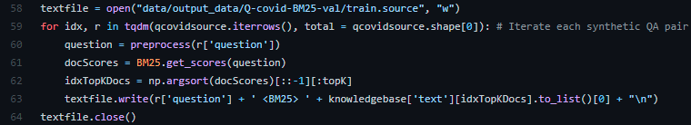
Question enhancement
We want to improve retrieval performance by enhancing the information in the input question
Our algorithm can be summarised as follows:
Iterate through a synthetic QA pair
Using a BM25 model, retrieve the closest matching passage to the question
We append this passage to the input question with a unique <BM25> token
Save enhanced QA pair
Notes:
We believe that adding an additional BM25 signal to the question will help the DPR have an easier time retrieving relevant documents. Since the DPR will be able to search the knowledge base using both the synthetic question and BM25 passage.
Iterate through a synthetic QA pair
Use a BM25 model retrieve the closest matching document to the question (similar to BlenderBot 2.0’s internet search) Instead of searching through the web, we search through a knowledge base
We append this passage to the input question with a unique <BM25> token, that separates the question and the enhanced input information
Save enhanced QA pair (The answer is the same for the original question and enhanced question)

Slide 22
examples
Original Question | Enhanced Question
What is the main cause of HIV-1 infection in children? | What is the main cause of HIV-1 infection in children? <BM25> Fifty-one children had primary dengue infection and...
What plays the crucial role in the Mother to Child Transmission of HIV-1 and what increases the risk? | What plays the crucial role in the Mother to Child Transmission of HIV-1 and what increases the risk? <BM25> DC-SIGNR plays a crucial role in MTCT of HIV-1 and...
How many children were infected by HIV-1 in 2008-2009? | How many children were infected by HIV-1 in 2008-2009? <BM25> gastroenteritis in breastfed children infected with E. coli serogroup O 111 compared to...
Notes:
These are some examples of enhanced questions that we have generated. The synthetic answer remains the same, the only difference is that we add an additional BM25 signal to the question. The BM25 token is added to help the model differentiate between the question and the passage provided by BM25.
NOTE; The answer is the same for both and the context is the same for both

Slide 23
Testing our hypothesis
To test our hypothesis, we enhanced an existing synthetic QA data set
We also enhanced the 2K COVID-QA validation data set
We have two scenarios to test our hypothesis:
175K synthetic QA pairs
175K enhanced synthetic QA pairs
We then fine-tuned RAG for each scenario and use the corresponding COVID-QA data set to evaluate performance
We compare the exact match (EM) scores across the two scenarios
Notes:
In our experiment, we used the original synthetic dataset created by Shamane, and it consists of about 175K QA pairs.
We then created an enhanced version with the same dataset.
We also enhanced the 2K covid-qa dataset, which was then used for validation.
Finally, we fine-tuned two RAG models, one with the original synthetic data set and the enhanced version. The validation set was then run on each of the models so that we can evaluate performance.
The exact match scores were then used to compare the two scenarios.

Slide 24
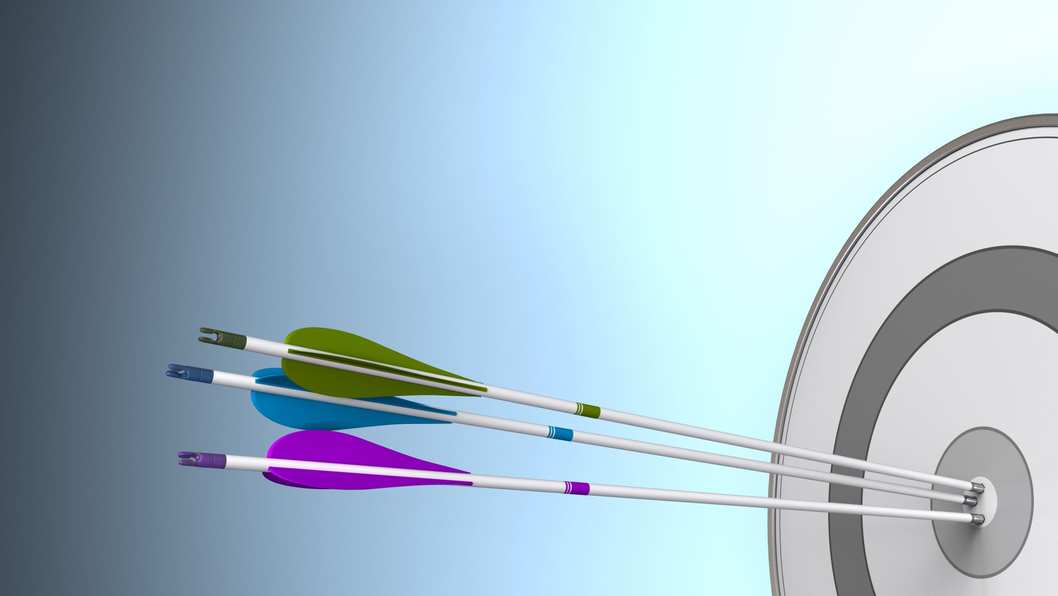
Results And DISCUSSION

Slide 25
Results
 | Abstractive Summarisation | Question Enhancement
Retrieval Collapse | Yes | Yes
Improved RAG Performance | No | ~20% ↑ EM score
Notes:
Both experiments conducted, resulted in retrieval collapse.
Since the retriever collapsed in the abstractive summarisation method, we believe the performance of RAG was similar to BART on its own, as the passages provided by the DPR would not help generate an answer in any way.
For our question enhancement method, we found that even with the retriever collapsing we still get a 20% increase in exact match score.
Our abstractive summarisation method showed no improved RAG performance. However, we saw a 20% increase in EM score for our question enhancement method.
The use of secondary self supervised signals help synthetic QA based domain adaptation, as shown in the results. With the additional signals there is an improvement, even if its relatively small.
Use of synthetic data can help domain adaptation.
RAG end-2-end fine-tuning improves domain adaptation more than training them separately
Synthetic data is more useful for answer generation, and less useful for document retrieval.
Both methods resulted in retrieval collapse.
The synthetic data via abstractive summarization did not improve RAG. Instead, it performed equivalently to BART.
The question enhancement method improved the EM score by about 20%.

Slide 26
Retrieval Collapse
For both methods, we hypothesised that RAG would improve the EM score because the synthetic QA pairs are less ambiguous and have more information. However, we observed retrieval collapse.
Retrieval collapse means the retriever learns to retrieve the same document regardless of the input question.
Retrieval collapse is likely due to longer target sequences.
This results in RAG learning to neglect the retriever, so performance is similar to a regular BART model.
Notes:
For both methods, we hypothesised that RAG would improve the EM score since the synthetic QA pairs are less ambiguous and the retriever is given supplementary information. However, we observed retrieval collapse in both experiments.
Retrieval collapse refers to the case where the retriever learns to retrieve the same documents regardless of the input question. This means the retrieved document won’t have any relevance to the current question.
According to the original paper, retrieval collapse could be due to three main reasons (P. Lewis, Perez, et al., 2020):
There is a less-explicit requirement for factual knowledge in some tasks.
Longer target sequences, which could result in less informative gradients for the retriever.
Spurious retrieval results when optimising a retrieval component in order to improve performance on downstream tasks.
However, for us we believe the main reason is due to longer target sequences. This is because some of our summaries (which are used as the answers to our synthetic question) are quite long. As a result this could result in less informative gradients for the retriever.
Because the retrieved documents have no relevance to the question, the BART model learns to neglect the retriever and instead uses only the question and it’s own parametric knowledge to generate an answer.
Both methods resulted in retrieval collapse.
The synthetic data via abstractive summarization did not improve RAG. Instead, it would perform equivalently to BART because it did not make use of the retrieval component.

Slide 27
Improved performance for question enhancement
Our results validated our hypothesis that increasing the amount of input information, increases RAG’s performance (↑ EM score).
However, the reoccurring retrieval collapse suggests that the increase in performance of RAG is merely a result of increasing the context of the question through an initial BM25 search.
The model did not improve due to an improved ability to search for relevant passages to answer the question.
Furthermore, this suggests the model learns that it is not essential to retrieve additional passages to answer the question since the enhanced question provides sufficient knowledge.
This is an important finding as it shows lexical matching models can help RAG.
Notes:
Our results validated our hypothesis that increasing the amount of input information, increases RAG’s performance (EM score)
However, the reoccurring retrieval collapse suggests that the increase in performance of RAG is merely a result of increasing the context of the question through an initial BM25 search.
The model did not improve due to an improved ability to search for relevant passages to answer the question
Furthermore, this suggests the model learns that it is not essential to retrieve additional passages to answer the question since the enhanced question provides sufficient knowledge.

Slide 28
Leveraging open-source models
The question enhancement technique had a limited knowledge base
We relied on external help to fine-tune RAG full end-2-end
Google Colab limited our round-trip consistency method
Limitations of Research
Notes:
Leveraging open-source models with the assumption that they work as intended
The question enhancement technique had a limited knowledge base. We used the same knowledge base as RAG would could have hindered its effectiveness.
In BlenderBot 2.0, they used an internet search query, which would have a much larger knowledge base.
To fine-tune RAG fully end-2-end, we received help from our PhD supervisor, so we were unable to modify specific parameters and experiment with other ideas. Our research was limited to what was coded in his pipeline
We also run into Google Colab limits which meant that it was difficult to fully process our initial synthetic data set using our round-trip consistency method.

Slide 29
Next steps
Combine both methods
Fine-tune and train our own summarisation and question generation models
More research into data-centric methods is required to improve RAG
Notes:
Fine-tune and train our own summarization and question generation models, instead of relying on free open0source models that may not be built for puspose for our research
As mentioned as one of our limitations above, the reliance on free and open-source models from the Huggingface Transformer’s library may have led to sub-par results. Ideally, we will train and fine-tuned our own text summarisation and question generation model as our next step. Doing so will ensure that our synthetically generated QA pairs are of the highest possible quality.
As stated above, the retriever collapsed from our synthetic QA, and this was likely due to the longer summarised answers making it hard for RAG to utilise the retriever. Likewise, the retriever collapses when sufficient information is provided to the input question. Therefore, if both the input sequence (enhanced questions) and output sequence (summarised answers) were long, this would prevent the retriever from collapsing since RAG would be forced to widen its knowledge when answering questions.
Finally, more research into data-centric methods is required to improve RAG

Slide 30
Conclusion
Our research presented two data-centric contributions to improve the performance of RAG, with a focus on the COVID-19 domain, and they were:
Generation of unambiguous synthetic QA pairs using an abstractive summarisation method
We found that an abstractive approach to generate unambiguous synthetic QA pairs resulted in retrieval collapse, a phenomenon that occurs due to a longer target sequence.
Enhancement of information to the input question for improving the retriever component in RAG.
We found that appending related passages to the input question improves RAG’s exact match score by about 20%, but this is not a result of the retriever making better judgments as we still observed retrieval collapse.
We also had two indirect contributions:
Dense vector embeddings for round trip consistency
RAG pipeline implementation
Overall, our research showed that further efforts focusing on data-centric techniques are required to improve RAG’s ODQA performance without the issue of retrieval collapse.

Slide 31
Thank you
Andrew Wang
Jaime Wu

